Slide 1
Case-Based Triage Scenarios

Slide 2
These case-based scenarios have been developed as an educational training tool to illustrate application of the National Guideline for the Field Triage of Injured Patients.
EMS and trauma systems vary significantly across the US. Consider your own specific circumstances throughout these cases to help you make timely triage decisions in real-life about patient destination, bypassing other hospitals, and transport mode.
Notes:
INSTRUCTORS:
Multiple case scenarios have been developed to facilitate education and training to apply the National Field Triage Guideline in practice. Covering all cases is not necessary depending on time constraints; it is recommended to cover at least 3-5 cases. Choose a variety of cases that cover Injury Patterns, Mental Status & Vital Signs, Mechanism of Injury, & EMS Judgment criteria from the Guideline to illustrate how each set of criteria is applied to injured patients.
The cases contain the ABCD primary survey and secondary survey to clarify if a patient does or does not meet the specific criterion.

Slide 3
In each scenario there will be one patient to assess and make a triage decision.
The Field Triage Guideline was developed using the best available evidence to identify patients that are most likely to benefit from the resources of a trauma center. They are not meant to supersede local trauma triage protocols and are not intended for mass casualty incident (MCI) triage.
Notes:
INSTRUCTORS:
Multiple case scenarios have been developed to facilitate education and training to apply the National Field Triage Guideline in practice. Covering all cases is not necessary depending on time constraints; it is recommended to cover at least 3-5 cases. Choose a variety of cases that cover Injury Patterns, Mental Status & Vital Signs, Mechanism of Injury, & EMS Judgment criteria from the Guideline to illustrate how each set of criteria is applied to injured patients.
The cases contain the ABCD primary survey and secondary survey to clarify if a patient does or does not meet the specific criterion.

Slide 4
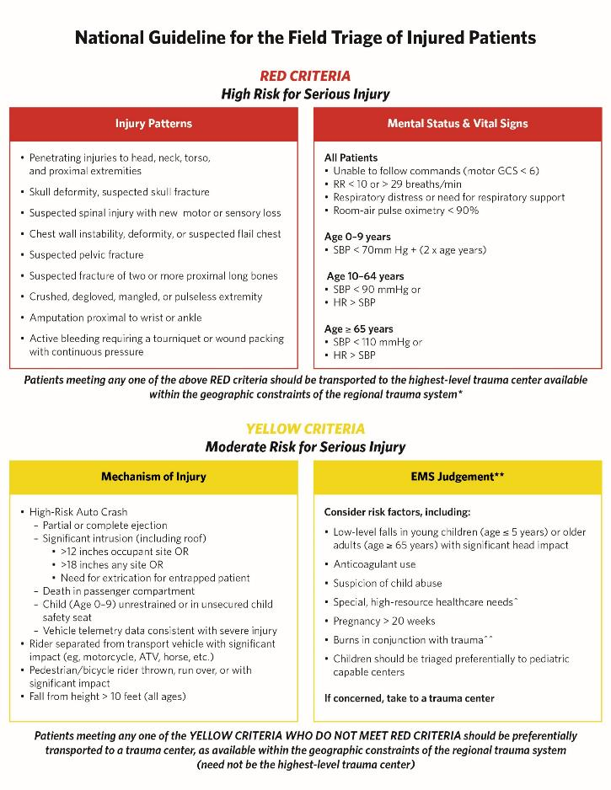
Notes:
INSTRUCTORS:
If you have not already, review the Field Triage Guidelines here.

Slide 5
What are the resources and structure of your local trauma system?
Trauma centers of each level and transport time/distance
Local non-trauma center hospitals
Air medical services and time to request & arrive on scene
Other ambulance coverage & need for mutual aid
Geographic constraints or other unique resources and challenges
Notes:
INSTRUCTORS:
Begin with a brief discussion of relevant EMS and trauma center resources of your system. The resources may include trauma centers of different levels, non-trauma center hospitals, air medical transport resources, other EMS coverage, or need for mutual aid. Additionally, it is important to consider geographic constraints or other challenges unique to the EMS and trauma system. Consider these resources and geographic constraints as you guide the trainees through the following cases.

Slide 6
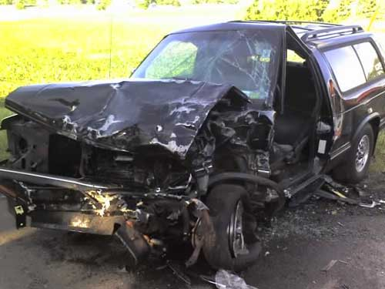
Case 1
Dispatch Info: Passenger vehicle rear-end collision into Garbage truck, unknown injuries.
Scene Size Up: SUV with damage as shown. Middle-aged male driver restrained, still in vehicle.
Primary survey:
A – Answering your questions when you approach
B – Regular, non-labored
C – Rapid radial pulse, cool skin
D – Following commands, confused about where he is & what happened
Secondary survey:
Exam – Scattered facial abrasions, abdomen tender lower quadrants, seat-belt sign across lower abdomen, swollen & tender left knee/shin
Initial vital signs – BP 96/52 HR 124 RR 20 SpO2 97% RA GCS 14 (E4 V4 M6)
History – HTN, on anti-HTN medication
Initial Thoughts?
Source: Joshua Brown, MD MSc FACS. Used with permission
Notes:
Discussion Points: Consider the following based on your specific EMS and trauma system resources and geographic constraints
Criterion demonstrated – Shock Index >1 (e.g. HR>SBP): HR 124, SBP 96 → RED criterion, should go to highest level trauma center available
System & resource considerations –
Bypass other centers –
Patient destination –
Transport mode –

Slide 7
Case 1
Dispatch Info: Passenger vehicle rear-end collision into Garbage truck, unknown injuries.
Scene Size Up: SUV with damage as shown. Middle-aged male driver restrained, still in vehicle.
Primary Survey:
A – Answering your questions when you approach
B – Regular, non-labored
C – Rapid radial pulse, cool skin
D – Following commands, confused about where he is & what happened
Secondary survey:
Exam – Scattered facial abrasions, abdomen tender lower quadrants, seat-belt sign across lower abdomen, swollen & tender left knee/shin
Initial vital signs – BP 96/52 HR 124 RR
20 SpO2 97% RA GCS 14 (E4 V4 M6)
History – HTN, on anti-HTN medication
Patient Destination?
Source: Joshua Brown, MD MSc FACS. Used with permission
Notes:
Discussion Points: Consider the following based on your specific EMS and trauma system resources and geographic constraints
Criterion demonstrated – Shock Index >1 (e.g. HR>SBP): HR 124, SBP 96 → RED criterion, should go to highest level trauma center available
System & resource considerations –
Bypass other centers –
Patient destination –
Transport mode –

Slide 8

Case 1
Dispatch Info: Passenger vehicle rear-end collision into Garbage truck, unknown injuries.
Scene Size Up: SUV with damage as shown. Middle-aged male driver restrained, still in vehicle.
Primary Survey:
A – Answering your questions when you approach
B – Regular, non-labored
C – Rapid radial pulse, cool skin
D – Following commands, confused about where he is & what happened
Secondary Survey:
Exam – Scattered facial abrasions, abdomen tender lower quadrants, seat-belt sign across lower abdomen, swollen & tender left knee/shin
Initial vital signs – BP 96/52 HR 124 RR 20 SpO2 97% RA GCS M 6
History – HTN, on anti-HTN medication
Changes to Your Plan?
Source: Joshua Brown, MD MSc FACS. Used with permission
Notes:
Discussion Points: Consider the following based on your specific EMS and trauma system resources and geographic constraints
Criterion demonstrated – Shock Index >1 (e.g. HR>SBP): HR 124, SBP 96 → RED criterion, should go to highest level trauma center available
System & resource considerations –
Bypass other centers –
Patient destination –
Transport mode –

Slide 9
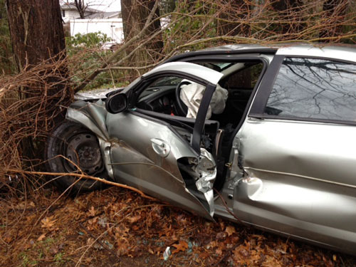
Case 2A
Dispatch Info: Two-car MVC, one car over embankment, possible injuries. You and a second unit are dispatched.
Scene Size Up: Sedan over embankment, damage as shown. Young female restrained driver responding but confined by damaged door. Air bags deployed. Door is popped by rescue & patient able to self-extricate.
Primary survey:
A – Yelling for help, answers questions
B – Regular, non-labored
C – Regular radial pulse, warm skin
D – Following commands,
agitated about wreck
Secondary
survey:
Exam – Scattered small facial & arm lacs from glass, obviously deformed right shin with bruising
Initial vital signs – BP 112/68 HR 96 RR 18 SpO2 99% RA GCS 15
Initial Thoughts?
Source: Mark Gestring, MD FACS. Used with permission
Notes:
Discussion Points: Consider the following based on your specific EMS and trauma system resources and geographic constraints
Criterion demonstrated – Need for extrication for entrapped patient → YELLOW criteria, should go to trauma center not necessarily highest level available (if no RED criteria met)
Patient does NOT meet this criterion, does not need a trauma center if no other criteria met. Popping a door does not rise to level of extrication for entrapment.
System & resource considerations –
Bypass other centers –
Patient destination –
Transport mode –

Slide 10

Case 2A
Dispatch Info: Two-car MVC, one car over embankment, possible injuries. You and a second unit are dispatched.
Scene Size Up: Sedan over embankment, damage as shown. Young female restrained driver responding but confined by damaged door. Air bags deployed. Door is popped by rescue & patient able to self-extricate.
Primary Survey:
A – Yelling for help, answers questions
B – Regular, non-labored
C – Regular radial pulse, warm skin
D – Following commands, agitated about wreck
Secondary survey:
Exam – Scattered small facial & arm lacs from glass, obviously deformed right shin with bruising
Initial vital signs – BP 112/68 HR 96 RR 18 SpO2 99% RA GCS 15
History – None
Patient Destination?
Source: Mark Gestring, MD FACS. Used with permission
Notes:
Discussion Points: Consider the following based on your specific EMS and trauma system resources and geographic constraints
Criterion demonstrated – Need for extrication for entrapped patient → YELLOW criteria, should go to trauma center not necessarily highest level available (if no RED criteria met)
Patient does NOT meet this criterion, does not need a trauma center if no other criteria met. Popping a door does not rise to level of extrication for entrapment.
System & resource considerations –
Bypass other centers –
Patient destination –
Transport mode –

Slide 11
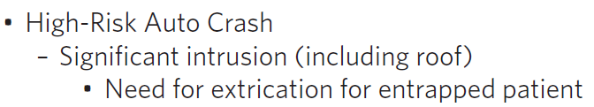
Case 2A
Dispatch Info: Two-car MVC, one car over embankment, possible injuries. You and a second unit are dispatched.
Scene Size Up: Sedan over embankment, damage as shown. Young female restrained driver responding but confined by damaged door. Air bags deployed. Door is popped by rescue & patient able to self-extricate.
Primary Survey:
A – Yelling for help, answers questions
B – Regular, non-labored
C – Regular radial pulse, warm skin
D – Following commands, agitated about wreck
Secondary Survey:
Exam – Scattered small facial & arm lacs from glass, bilateral shins with bruising
Initial vital signs – BP 112/68 HR 96 RR 18 SpO2 99% RA GCS M 6
History – None
Changes to Your Plan?
Source: Mark Gestring, MD FACS. Used with permission
Notes:
Discussion Points: Consider the following based on your specific EMS and trauma system resources and geographic constraints
Criterion demonstrated – Need for extrication for entrapped patient → YELLOW criteria, should go to trauma center not necessarily highest level available (if no RED criteria met)
Patient does NOT meet this criterion, does not need a trauma center if no other criteria met. Popping a door does not rise to level of extrication for entrapment.
System & resource considerations –
Bypass other centers –
Patient destination –
Transport mode –

Slide 12
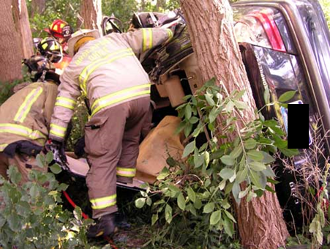
Case 2B
Dispatch Info: Two-car MVC, one car over embankment, possible injuries. You and a second unit are dispatched.
Scene Size Up: Sedan over embankment resting on side as shown. Young female restrained driver responding but lower extremities entrapped under dash. Rescue removes the roof and performs dash roll to extricate patient, takes ~25 minutes to get patient out.
Primary survey:
A – Yelling for help, answers questions
B – Regular, non-labored
C – Regular radial pulse, warm skin
D – Following commands, agitated about wreck
Exam – Scattered small facial & arm lacs from glass, obviously deformed right shin with bruising
Initial vital signs – BP 112/68 HR 96 RR 18 SpO2 99% RA GCS 15
History – None
Initial Thoughts?
Source: Mark Gestring, MD FACS. Used with permission
Notes:
Discussion Points: Consider the following based on your specific EMS and trauma system resources and geographic constraints
Criterion demonstrated – Need for extrication for entrapped patient → YELLOW criteria, should go to trauma center not necessarily highest level available (if no RED criteria met)
This level of extrication does meet the extrication for entrapment criterion and is associated with a high risk of severe injury. The patient should be taken to a trauma center.
System & resource considerations –
Bypass other centers –
Patient destination –
Transport mode –

Slide 13
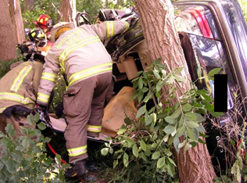
Case 2B
Dispatch Info: Two-car MVC, one car over embankment, possible injuries. You and a second unit are dispatched.
Scene Size Up: Sedan over embankment resting on side as shown. Young female restrained driver responding but lower extremities entrapped under dash. Rescue removes the roof and performs dash roll to extricate patient, takes ~25 minutes to get patient out.
Primary Survey:
A – Yelling for help, answers questions
B – Regular, non-labored
C – Regular radial pulse, warm skin
D – Following commands, agitated about wreck
Secondary surve
y: facial & arm lacs from glass, obviously deformed right shin with bruising
Initial vital signs – BP 112/68 HR 96 RR 18 SpO2 99% RA GCS 15
History – None
Patient Destination?
Source: Mark Gestring, MD FACS. Used with permission
Notes:
Discussion Points: Consider the following based on your specific EMS and trauma system resources and geographic constraints
Criterion demonstrated – Need for extrication for entrapped patient → YELLOW criteria, should go to trauma center not necessarily highest level available (if no RED criteria met)
This level of extrication does meet the extrication for entrapment criterion and is associated with a high risk of severe injury. The patient should be taken to a trauma center.
System & resource considerations –
Bypass other centers –
Patient destination –
Transport mode –

Slide 14
Case 2B
Dispatch Info: Two-car MVC, one car over embankment, possible injuries. You and a second unit are dispatched.
Scene Size Up: Sedan over embankment resting on side as shown. Young female restrained driver responding but lower extremities entrapped under dash. Rescue removes the roof and performs dash roll to extricate patient, takes ~25 minutes to get patient out.
Primary Survey:
A – Yelling for help, answers questions
B – Regular, non-labored
C – Regular radial pulse, warm skin
D – Following commands, agitated about wreck
Secondary Survey:
Exam – Scattered small facial & arm lacs from glass, bilateral shins with bruising
Initial vital signs – BP 112/68 HR 96 RR 18 SpO2 99% RA GCS M 6
History – None
Changes to Your Plan?
Source: Mark Gestring, MD FACS. Used with permission
Notes:
Discussion Points: Consider the following based on your specific EMS and trauma system resources and geographic constraints
Criterion demonstrated – Need for extrication for entrapped patient → YELLOW criteria, should go to trauma center not necessarily highest level available (if no RED criteria met)
This level of extrication does meet the extrication for entrapment criterion and is associated with a high risk of severe injury. The patient should be taken to a trauma center.
System & resource considerations –
Bypass other centers –
Patient destination –
Transport mode –

Slide 15
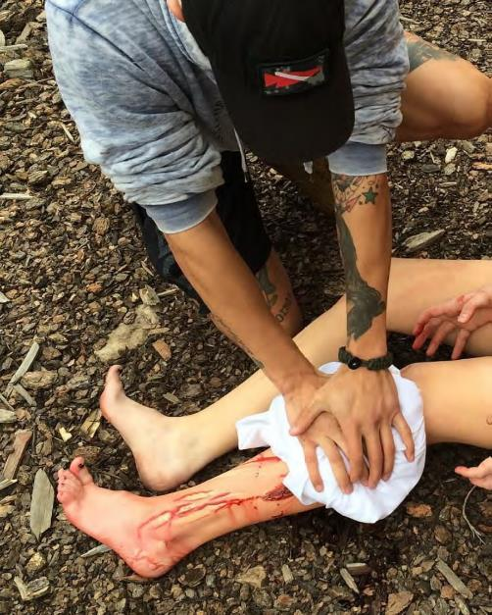
Case 3
Dispatch Info: Young female fell while standing on a chair, significant bleeding reported from leg wound.
Scene Size Up: Family home, around in back yard you find overturned chair & shattered glass table. There’s a large amount of blood on ground and patient. Family is holding bloody towel on left leg.
Primary survey:
A – Able to answer questions
B – Regular, non-labored
C – Mildly diaphoretic, palpable radial pulse in both arms
D – Following commands, alert and oriented
Secondary survey:
Exam – Multiple
deep lacerations to the right upper arm and forearm, down to muscle. One laceration has spurting blood when removing the towel
bystanders are using, HTN, HLD. No anticoagulant meds, baby aspirin
Initial Thoughts?
Source: American College of Surgeons. Used with permission
Notes:
Discussion Points: Consider the following based on your specific EMS and trauma system resources and geographic constraints
Criterion demonstrated – Active bleeding requiring a tourniquet or wound packing with continuous pressure → RED criterion, should go to highest level trauma center available
System & resource considerations –
Bypass other centers –
Patient destination –
Transport mode –

Slide 16

Case 3
Dispatch Info: Young female fell while standing on a chair, significant bleeding reported from leg wound.
Scene Size Up: Family home, around in back yard you find overturned chair & shattered glass table. There’s a large amount of blood on ground and patient. Family is holding bloody towel on left leg.
Primary Survey:
A – Able to answer questions
B – Regular, non-labored
C – Mildly diaphoretic, palpable radial pulse in both arms
D – Following commands, alert and oriented. States she fell off a chair onto a glass table.
Secondary surve
y:
Exam – Multiple deep lacerations to the right upper arm and forearm, down to mt slows the bleeding.
Initial vital sign
s – BP 110/72 – CAD, DM, HTN, HLD. No anticoagulant meds, baby aspirin
Patient Destination?
Source: American College of Surgeons. Used with permission
Notes:
Discussion Points: Consider the following based on your specific EMS and trauma system resources and geographic constraints
Criterion demonstrated – Active bleeding requiring a tourniquet or wound packing with continuous pressure → RED criterion, should go to highest level trauma center available
System & resource considerations –
Bypass other centers –
Patient destination –
Transport mode –

Slide 17
Case 3
Dispatch Info: Young female fell while standing on a chair, significant bleeding reported from leg wound.
Scene Size Up: Family home, around in back yard you find overturned chair & shattered glass table. There’s a large amount of blood on ground and patient. Family is holding bloody towel on left leg.
Primary Survey:
A – Able to answer questions
B – Regular, non-labored
C – Mildly diaphoretic, palpable radial pulse in both arms
D – Following commands, alert and oriented. States she fell off a chair onto a glass table.
Secondary Survey:
Exam – Long deep laceration lateral left calf, down to muscle. Spurting blood when removing the towel bystanders are using for pressure. You place a commercial tourniquet that stops the bleeding.
Initial vital signs – BP 110/72 HR 102 RR 12 SpO2 98% RA GCS M 6
History – None
Changes to Your Plan?
Source: American College of Surgeons. Used with permission
Notes:
Discussion Points: Consider the following based on your specific EMS and trauma system resources and geographic constraints
Criterion demonstrated – Active bleeding requiring a tourniquet or wound packing with continuous pressure → RED criterion, should go to highest level trauma center available
System & resource considerations –
Bypass other centers –
Patient destination –
Transport mode –

Slide 18
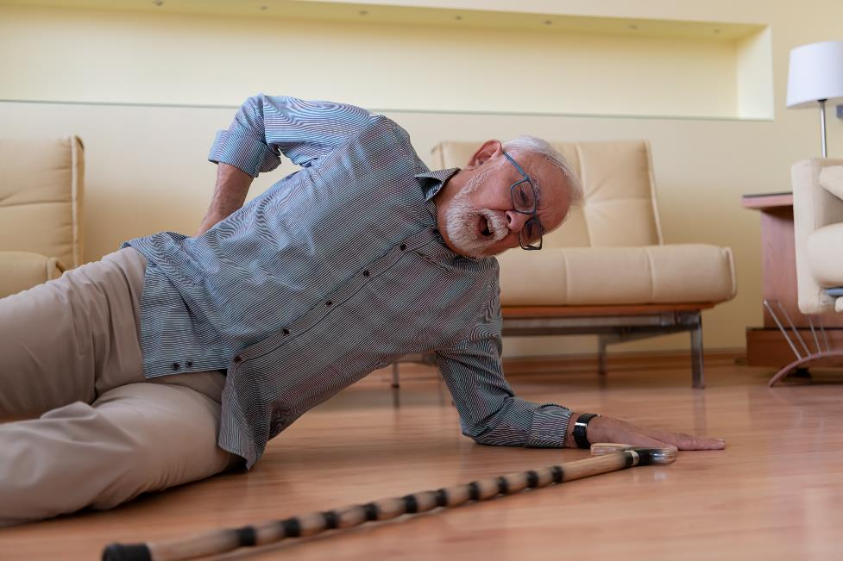
Case 4A
Dispatch Info: Elderly male ground level fall.
Scene Size Up: Elderly male lying on ground with cane nearby. Lives alone.
Primary survey:
A – Answers questions
B – Regular, non-labored
C – Regular radial pulse, warm skin
D – Following commands, oriented, states he tripped when was not using his walker
Secondary survey:
Exam – Small skin tear on left hand not bleeding, no obvious head trauma, patient unsure if he hit his head
Initial vital signs – BP 168/84 HR 84 RR 12 SpO2 96% RA GCS 15
History – CAD, HTN, OA. No anticoagulants o
antiplatelets
Initial Thoughts?
Source: Getty Images. Used with permission
Notes:
Discussion Points: Consider the following based on your specific EMS and trauma system resources and geographic constraints
Criterion demonstrated – EMS Judgment: additional risk factors of lower level fall in older adult with significant head impact → YELLOW criteria, should go to trauma center not necessarily highest level available (if no RED criteria met)
Unclear if significant head impact. In absence of other risk factors or triage criteria, may be reasonable in EMS judgment that patient does not meet this criterion and can go to a non-trauma center.
System & resource considerations –
Bypass other centers –
Patient destination –
Transport mode –

Slide 19

Case 4A
Dispatch Info: Elderly male ground level fall.
Scene Size Up: Elderly male lying on ground with cane nearby. Lives alone.
Primary Survey:
A – Answers questions
B – Regular, non-labored
C – Regular radial pulse, warm skin
D – Following commands, oriented, states he tripped
Secondary survey:
Exam – Small skin tear on left hand not bleeding, no obvious head trauma, patient unsure if he hit his head
Initial vital signs – BP 168/84 HR 84 RR 12 SpO2 96% RA GCS 15
History – CAD, HTN, OA. No anticoagulants or antiplatelets
Patient Destination?
Source: Getty Images. Used with permission
Notes:
Discussion Points: Consider the following based on your specific EMS and trauma system resources and geographic constraints
Criterion demonstrated – EMS Judgment: additional risk factors of lower level fall in older adult with significant head impact → YELLOW criteria, should go to trauma center not necessarily highest level available (if no RED criteria met)
Unclear if significant head impact. In absence of other risk factors or triage criteria, may be reasonable in EMS judgment that patient does not meet this criterion and can go to a non-trauma center.
System & resource considerations –
Bypass other centers –
Patient destination –
Transport mode –

Slide 20

Case 4A
Dispatch Info: Elderly male ground level fall.
Scene Size Up: Elderly male lying on ground with cane nearby. Lives alone.
Primary Survey:
A – Answers questions
B – Regular, non-labored
C – Regular radial pulse, warm skin
D – Following commands, oriented, states he tripped
Secondary Survey:
Exam – Small skin tear on left hand not bleeding, no obvious head trauma, patient unsure if he hit his head
Initial vital signs – BP 168/84 HR 84 RR 12 SpO2 96% RA GCS M 6
History – CAD, HTN, OA. No anticoagulants or antiplatelets
Changes to Your Plan?
Source: Getty Images. Used with permission
Notes:
Discussion Points: Consider the following based on your specific EMS and trauma system resources and geographic constraints
Criterion demonstrated – EMS Judgment: additional risk factors of lower level fall in older adult with significant head impact → YELLOW criteria, should go to trauma center not necessarily highest level available (if no RED criteria met)
Unclear if significant head impact. In absence of other risk factors or evidence of head trauma, may be reasonable in EMS judgment that patient does not meet this criterion and can go to a non-trauma center.
System & resource considerations –
Bypass other centers –
Patient destination –
Transport mode –

Slide 21
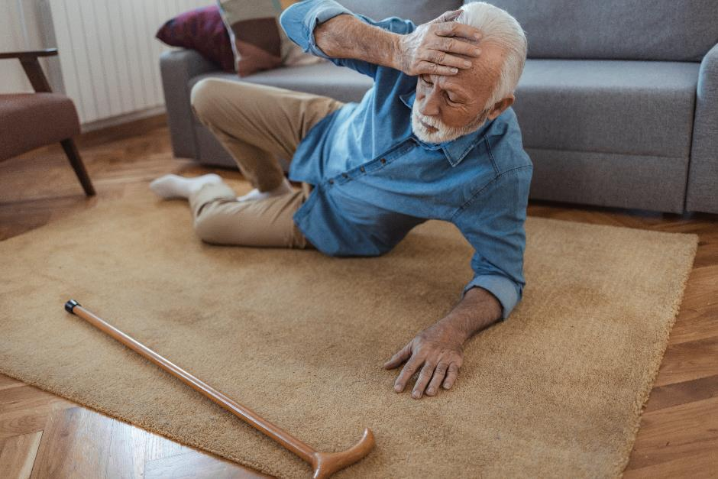
Case 4B
Dispatch Info: Elderly male ground level fall.
Scene Size Up: Elderly male lying on ground near couch. Lives alone.
Primary survey:
A – Answers questions
B – Regular, non-labored
C – Regular radial pulse, warm skin
D – Following commands, oriented to person, place. States he tripped on rug
Secondary survey:
Exam – Large hematoma on left forehead with small overlying skin tear. Multiple bruises on both arms, some appear old.
Initial vital signs – BP 168/84 HR 84 RR 12 SpO2 96% RA GCS 15
History – CAD, HTN, OA, afib. On warfarin (Coumadin)
Initial Thoughts?
Source: Getty Images. Used with permission
Notes:
Discussion Points: Consider the following based on your specific EMS and trauma system resources and geographic constraints
Criterion demonstrated – EMS Judgment: additional risk factors of lower level fall in older adult with significant head impact + Anticoagulation use → YELLOW criteria, should go to trauma center not necessarily highest level available (if no RED criteria met)
Multiple additional risk factors including anticoagulation in setting of evidence of significant head impact. Likely patients should be taken to a trauma center.
System & resource considerations –
Bypass other centers –
Patient destination –
Transport mode –

Slide 22

Case 4B
Dispatch Info: Elderly male ground level fall.
Scene Size Up: Elderly male lying on ground near couch. Lives alone.
Primary Survey:
A – Answers questions
B – Regular, non-labored
C – Regular radial pulse, warm skin
D – Following commands, oriented to person, place. States he tripped on rug
Secondary survey:
Exam – Large hematoma on left forehead with small overlying skin tear. Multiple bruises on both arms, some appear old.
Initial vital signs – BP 168/84 HR 84 RR 12 SpO2 96% RA GCS 15
History – CAD, HTN, OA, afib. On warfarin (Coumadin)
Patient Destination?
Source: Getty Images. Used with permission
Notes:
Discussion Points: Consider the following based on your specific EMS and trauma system resources and geographic constraints
Criterion demonstrated – EMS Judgment: additional risk factors of lower level fall in older adult with significant head impact + Anticoagulation use → YELLOW criteria, should go to trauma center not necessarily highest level available (if no RED criteria met)
Multiple additional risk factors including anticoagulation in setting of evidence of significant head impact. Likely patients should be taken to a trauma center.
System & resource considerations –
Bypass other centers –
Patient destination –
Transport mode –

Slide 23
Case 4B
Dispatch Info: Elderly male ground level fall.
Scene Size Up: Elderly male lying on ground near couch. Lives alone.
Primary Survey:
A – Answers questions
B – Regular, non-labored
C – Regular radial pulse, warm skin
D – Following commands, oriented to person, place. States he tripped on rug
Secondary Survey:
Exam – Large hematoma on left forehead with small overlying skin tear. Multiple bruises on both arms, some appear old.
Initial vital signs – BP 168/84 HR 84 RR 12 SpO2 96% RA GCS M 6
History – CAD, HTN, OA, afib. On warfarin (Coumadin)
Changes to Your Plan?
Source: Getty Images. Used with permission
Notes:
Discussion Points: Consider the following based on your specific EMS and trauma system resources and geographic constraints
Criterion demonstrated – EMS Judgment: additional risk factors of lower level fall in older adult with significant head impact + Anticoagulation use → YELLOW criteria, should go to trauma center not necessarily highest level available (if no RED criteria met)
Multiple additional risk factors including anticoagulation in setting of evidence of significant head impact. Likely patients should be taken to a trauma center.
System & resource considerations –
Bypass other centers –
Patient destination –
Transport mode –

Slide 24
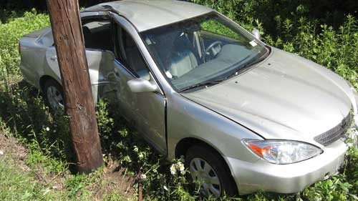
Case 5A
Dispatch Info: Single car MVC, side impact into telephone pole.
Scene Size Up: Driver still in car. Damage as shown. He was not wearing a seatbelt.
Initial Thoughts?
Source: Mark Gestring, MD FACS. Used with permission
Notes:
Discussion Points: Consider the following based on your specific EMS and trauma system resources and geographic constraints
Criterion demonstrated – Significant intrusion (including roof) >12 inches occupant site OR >18 inches any site → YELLOW criteria, should go to trauma center not necessarily highest level available (if no RED criteria met)
Intrusion is away from occupant site, not >18 inches overall. Patient does NOT meet this criterion, does not need a trauma center if no other criteria met.
System & resource considerations –
Bypass other centers –
Patient destination –
Transport mode –

Slide 25
Case 5A
Dispatch Info: Single car MVC, side impact into telephone pole.
Scene Size Up: Driver still in car. Damage as shown. He was not wearing a seatbelt.
Primary Survey:
A – Responding to questions
B – Regular, non-labored respirations
C – Radial pulses strong, rapid rate
D – Alert, obeys commands, denies any LOC
Patient Destination?
Source: Mark Gestring, MD FACS. Used with permission
Notes:
Discussion Points: Consider the following based on your specific EMS and trauma system resources and geographic constraints
Criterion demonstrated – Significant intrusion (including roof) >12 inches occupant site OR >18 inches any site → YELLOW criteria, should go to trauma center not necessarily highest level available (if no RED criteria met)
Intrusion is away from occupant site, not >18 inches overall. Patient does NOT meet this criterion, does not need a trauma center if no other criteria met.
System & resource considerations –
Bypass other centers –
Patient destination –
Transport mode –

Slide 26
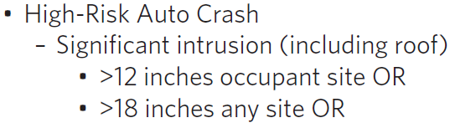
Case 5A
Dispatch Info: Single car MVC, side impact into telephone pole.
Scene Size Up: Driver still in car. Damage as shown. He was not wearing a seatbelt.
Primary Survey:
A – Responding to questions
B – Regular, non-labored respirations
C – Radial pulses strong, rapid rate
D – Alert, obeys commands, denies any LOC
Secondary Survey:
Exam – Contusion to left parietal area. Denies pain in neck, chest, abdomen, and moving all extremities, except LLE. Deformities noted in left ankle and foot.
Initial vital signs – BP 162/124 HR 114 RR 26 SpO2 95% RA GCS M 6
History – HTN, DM
Changes to Your Plan?
Source: Mark Gestring, MD FACS. Used with permission
Notes:
Discussion Points: Consider the following based on your specific EMS and trauma system resources and geographic constraints
Criterion demonstrated – Significant intrusion (including roof) >12 inches occupant site OR >18 inches any site → YELLOW criteria, should go to trauma center not necessarily highest level available (if no RED criteria met)
Intrusion is away from occupant site, not >18 inches overall. Patient does NOT meet this criterion, does not need a trauma center if no other criteria met.
System & resource considerations –
Bypass other centers –
Patient destination –
Transport mode –

Slide 27
Case 5B
Dispatch Info: Single car MVC, side impact into telephone pole.
Scene Size Up: Driver out standing by car. Rear right side passenger still in car. Damage as shown. Passenger was not wearing a seatbelt.
Initial Thoughts?
Source: Mark Gestring, MD FACS. Used with permission
Notes:
Discussion Points: Consider the following based on your specific EMS and trauma system resources and geographic constraints
Criterion demonstrated – Significant intrusion (including roof) >12 inches occupant site OR >18 inches any site → YELLOW criteria, should go to trauma center not necessarily highest level available (if no RED criteria met)
Intrusion for passenger is at the occupant site and >12 inches. Passenger does meet this criterion which is associated with a high risk of severe injury. The patient should be taken to a trauma center.
System & resource considerations –
Bypass other centers –
Patient destination –
Transport mode –

Slide 28
Case 5B
Dispatch info: Single car MVC, side impact into telephone pole.
Scene size up: Driver out standing by car. Rear right side passenger still in car. Damage as shown. Passenger was not wearing a seatbelt.
Primary survey:
A – Responding to questions
B – Regular, non-labored respirations
C – Radial pulses strong, rapid rate
D – Alert, obeys commands, denies any LOC
Patient Destination?
Source: Mark Gestring, MD FACS. Used with permission
Notes:
Discussion Points: Consider the following based on your specific EMS and trauma system resources and geographic constraints
Criterion demonstrated – Significant intrusion (including roof) >12 inches occupant site OR >18 inches any site → YELLOW criteria, should go to trauma center not necessarily highest level available (if no RED criteria met)
Intrusion for passenger is at the occupant site and >12 inches. Passenger does meet this criterion which is associated with a high risk of severe injury. The patient should be taken to a trauma center.
System & resource considerations –
Bypass other centers –
Patient destination –
Transport mode –

Slide 29
Case 5B
Dispatch info: Single car MVC, side impact into telephone pole.
Scene size up: Driver out standing by car. Rear right side passenger still in car. Damage as shown. Passenger was not wearing a seatbelt.
Primary survey:
A – Responding to questions
B – Regular, non-labored respirations
C – Radial pulses strong, rapid rate
D – Alert, obeys commands, denies any LOC
Secondary Survey:
Exam – Contusion to left parietal area, Denies pain in neck, chest, abdomen, and moving all extremities, except LLE. Deformities noted in left ankle and foot.
Initial vital signs – BP 162/124 HR 114 RR 26 SpO2 95% RA GCS M 6
History – HTN, DM
Changes to Your Plan?
Source: Mark Gestring, MD FACS. Used with permission
Notes:
Discussion Points: Consider the following based on your specific EMS and trauma system resources and geographic constraints
Criterion demonstrated – Significant intrusion (including roof) >12 inches occupant site OR >18 inches any site → YELLOW criteria, should go to trauma center not necessarily highest level available (if no RED criteria met)
Intrusion for passenger is at the occupant site and >12 inches. Passenger does meet this criterion which is associated with a high risk of severe injury. The patient should be taken to a trauma center.
System & resource considerations –
Bypass other centers –
Patient destination –
Transport mode –

Slide 30
Case 5C
Dispatch Info: Single car MVC, side impact into telephone pole.
Scene Size Up: Pregnant female driver still in car. Damage as shown. She was not wearing a seatbelt.
Initial Thoughts?
Source: Mark Gestring, MD FACS. Used with permission
Notes:
Discussion Points: Consider the following based on your specific EMS and trauma system resources and geographic constraints
Criterion demonstrated –
1. EMS Judgement: Pregnancy >20 weeks → YELLOW criteria, should go to trauma center not necessarily highest level available (if no RED criteria met)
2. Significant intrusion (including roof) >12 inches occupant site OR >18 inches any site → YELLOW criteria, should go to trauma center not necessarily highest level available (if no RED criteria met)
As in the first part of the case, the intrusion criteria are not met; however, with pregnancy >20 weeks and abdominal bruising, patient likely should be taken to a trauma center with OB capabilities.
System & resource considerations –
Bypass other centers –
Patient destination –
Transport mode –

Slide 31
Case 5C
Dispatch Info: Single car MVC, side impact into telephone pole.
Scene Size Up: Pregnant female driver still in car. Damage as shown. She was not wearing a seatbelt.
Primary Survey:
A – Responding to questions
B – Breathing non labored but rapid
C – No signs of bleeding, pulse rapid
D – Alert, obeys commands, denies any LOC
Patient Destination?
Source: Mark Gestring, MD FACS. Used with permission
Notes:
Discussion Points: Consider the following based on your specific EMS and trauma system resources and geographic constraints
Criterion demonstrated –
1. EMS Judgement: Pregnancy >20 weeks → YELLOW criteria, should go to trauma center not necessarily highest level available (if no RED criteria met)
2. Significant intrusion (including roof) >12 inches occupant site OR >18 inches any site → YELLOW criteria, should go to trauma center not necessarily highest level available (if no RED criteria met)
As in the first part of the case, the intrusion criteria are not met; however, with pregnancy >20 weeks and abdominal bruising, patient likely should be taken to a trauma center with OB capabilities.
System & resource considerations –
Bypass other centers –
Patient destination –
Transport mode –

Slide 32
Case 5C
Dispatch Info: Single car MVC, side impact into telephone pole.
Scene Size Up: Pregnant female driver still in car. Damage as shown. She was not wearing a seatbelt.
Primary Survey:
A – Responding to questions
B – Breathing non labored but rapid
C – No signs of bleeding, pulse rapid
D – Alert, obeys commands, denies any LOC
Secondary Survey:
Exam – Abdomen has large bruise to the left upper quadrant, size of baseball, tender on palpation. Uterus is firm at fundal height.
Initial vital signs – BP 114/52 HR 111 RR 28 SpO2 98% RA GCS M 6
History – She is 29 weeks pregnant, gravida 1, para 0
Changes to Your Plan?
Source: Mark Gestring, MD FACS. Used with permission
Notes:
Discussion Points: Consider the following based on your specific EMS and trauma system resources and geographic constraints
Criterion demonstrated –
1. EMS Judgement: Pregnancy >20 weeks → YELLOW criteria, should go to trauma center not necessarily highest level available (if no RED criteria met)
2. Significant intrusion (including roof) >12 inches occupant site OR >18 inches any site → YELLOW criteria, should go to trauma center not necessarily highest level available (if no RED criteria met)
As in the first part of the case, the intrusion criteria are not met; however, with pregnancy >20 weeks and abdominal bruising, patient likely should be taken to a trauma center with OB capabilities.
System & resource considerations –
Bypass other centers –
Patient destination –
Transport mode –

Slide 33

Case 6
Dispatch Info: Male fell off ladder.
Scene Size Up: Middle aged male lying on his back on concrete driveway, ladder lying next to him near 2 story roof. He’s alert and responsive.
Initial Thoughts?
Source: Getty Images. Used with permission
Notes:
Discussion Points: Consider the following based on your specific EMS and trauma system resources and geographic constraints
Criterion demonstrated –
1. Fall from height >10 feet (all ages) → YELLOW criteria, should go to trauma center not necessarily highest level available (if no RED criteria met)
2. Suspected spinal injury: New onset motor or sensory loss → RED criterion, should go to highest level trauma center available
System & resource considerations –
Bypass other centers –
Patient destination – Patient should go to the highest level of trauma center available because of the suspected spinal injury with inability to move his legs after the fall. He meets both a RED criterion and YELLOW criterion, and the RED criteria supersedes the YELLOW criterion for destination determination.
Transport mode –

Slide 34

Case 6
Dispatch Info: Male fell off ladder.
Scene Size Up: Middle aged male lying on his back on concrete driveway, ladder lying next to him near 2 story roof. He’s alert and responsive.
Primary Survey:
A – Answers questions
B – Regular, non-labored
C – Regular radial pulse, warm skin
D – Following commands. States up working on roof eaves and ladder gave out.
Patient Destination?
Source: Getty Images. Used with permission
Notes:
Discussion Points: Consider the following based on your specific EMS and trauma system resources and geographic constraints
Criterion demonstrated –
1. Fall from height >10 feet (all ages) → YELLOW criteria, should go to trauma center not necessarily highest level available (if no RED criteria met)
2. Suspected spinal injury: New onset motor or sensory loss → RED criterion, should go to highest level trauma center available
System & resource considerations –
Bypass other centers –
Patient destination – Patient should go to the highest level of trauma center available because of the suspected spinal injury with inability to move his legs after the fall. He meets both a RED criterion and YELLOW criterion, and the RED criteria supersedes the YELLOW criterion for destination determination.
Transport mode –

Slide 35
Case 6
Dispatch Info: Male fell off ladder.
Scene Size Up: Middle aged male lying on his back on concrete driveway, ladder lying next to him near 2 story roof. He’s alert and responsive.
Primary Survey:
A – Answers questions
B – Regular, non-labored
C – Regular radial pulse, warm skin
D – Following commands. States up working on roof eaves and ladder gave out.
Secondary Survey:
Exam – Hematoma to occiput. Cannot move lower extremities, states they are numb. Full strength in upper extremities. No obvious lower extremity deformities.
Initial vital – BP 152/110 HR 70 RR 22 SpO2 98% RA GCS M 6
History – HTN, CAD, CABGx2
Changes to Your Plan?
Source: Getty Images. Used with permission
Notes:
Discussion Points: Consider the following based on your specific EMS and trauma system resources and geographic constraints
Criterion demonstrated –
1. Fall from height >10 feet (all ages) → YELLOW criteria, should go to trauma center not necessarily highest level available (if no RED criteria met)
2. Suspected spinal injury: New onset motor or sensory loss → RED criterion, should go to highest level trauma center available
System & resource considerations –
Bypass other centers –
Patient destination – Patient should go to the highest level of trauma center available because of the suspected spinal injury with inability to move his legs after the fall. He meets both a RED criterion and YELLOW criterion, and the RED criteria supersedes the YELLOW criterion for destination determination.
Transport mode –

